Slide 1
Handwritten Digit Recognition

Slide 2
PROBLEM STATEMENT
“To Recognize and Convert, Handwritten Digits Into Digital Form With the Help Of Machine Learning”

Slide 3
State-of-the-art and their limitations
Anuj Dutt proved in his research that by applying Deep Learning systems, he was able to achieve extraordinarily high levels of accuracy. He achieved a 98.72 percent accuracy using the convolutional Neural Network with Keras and Theano as the backend. Furthermore, using Tensorflow to execute CNN yields a dramatically better result of 99.70 percent. Despite the fact that the technique and coding appear to be more complicated when compared to traditional Machine Learning algorithms, the precision he achieved is becoming increasingly apparent. Saeed AL-Mansoori released a paper in which he used a Multilayer Perceptron (MLP) Neural Network to recognise and forecast handwritten digits from 0 to 9. On a dataset obtained from MNIST, the suggested neural system was trained and tested.
Handwritten Recognition from the MNIST dataset is well-known among scientists. The goal is to build a Handwritten Digit Recognition framework and consider various classifiers and algorithms while focusing on getting as near to human performance as possible. The common issue faced in composing various numbers (0-9) for various persons would be the digit order issue and the closeness between the digits such as 1 and 7, 5 and 6, 3 and 8, 9 and 8, and so on. Additionally, because different persons write the same digit from different perspectives, the originality and variety in their handwriting has an impact on the development and presence of the digits

Slide 4
State-of-the-art and their limitations
Many studies on feature extraction and classifier techniques for handwritten digit recognition have been conducted. The majority of them had high recognition accuracy. Mane and Kulkarni (2018), for example, suggested a Customized Convolutional Neural Network (CNN) that can automatically learn features and predict numerical categories in a large data collection, such as Marathi, one of India's most widely spoken regional languages. Furthermore, utilising K-fold cross validation, the CCNN's performance averaged 94.93 percent accuracy. The suggested CCNN model does not set any limitations on the number of layers, but rather optimises it to meet the issue's requirement. The intermediate convolutional layer has also been subjected to the various filter sizes.

Slide 5
State-of-the-art and their limitations
The major limitations that we found in these existing ideas were that , it lacks a proper frontend designing.There is only one source of input. Therefore, we have come up with two input source where we can draw the digit in the sketch-pad or we can take a picture of the digit through a web camera, both at the same place. Also , the work has been done only in popular languages like English etc. We can further extend our ideas to work on HINDI and SIGN LANGUAGES for the deaf which can be a major invention in this area of Machine Learning.

Slide 6
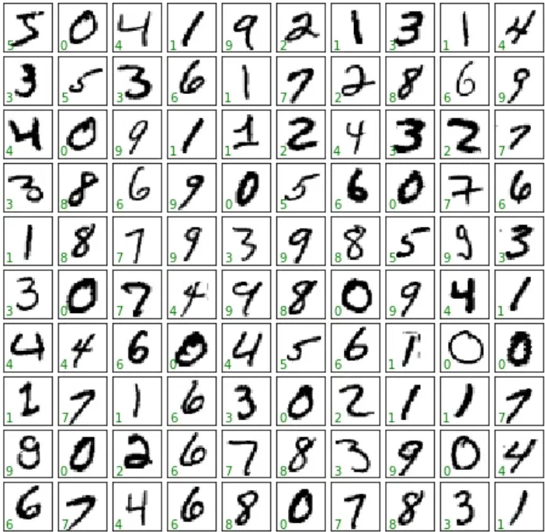
Proposed Design And Implementation
DATASET
The MNIST (Modified National Institute of Standards and Technology database)
The MNIST dataset contains 60,000 training images of handwritten digits from zero to nine and 10,000 images for testing. So, the MNIST dataset has 10 different classes.
The handwritten digits images are represented as a 28×28 matrix.

Slide 7
Proposed Design And Implementation continued...
01
Loading the MNIST dataset.
The Keras library already contains some datasets and MNIST is one of them.
The mnist.load_data() method returns us the training and testing data with their label respectively.
02
Reshaping the dataset Images
The image data can’t be fed directly into the model.
Dimension of the training data is (60000,28,28).
CNN model require one more dimension.
Reshaped matrix of training data is (60000,28,28,1)
03
Building CNN Model
Filter extraction and operation (Convolutional Layer).
Making the model Non-Linear using ReLU
Max Pooling (Pooling Layer)
Flattening
Full Connection
04
Evaluation
Evaluating on testing data.
Accuracy approx 99.14%
Model ready to use.
05
User Interface
GUI Sketchpad allow to sketch the digits
Web Camera allow us o show the live image of handwritten digits.
Bot these interface uses CNN model to recognize the digit and display in digital form.

Slide 8
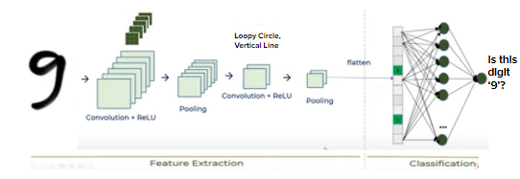
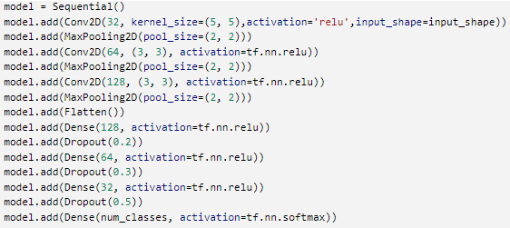
Proposed Design And Implementation continued...
Complete CNN model:
Code Implementation:

Slide 9
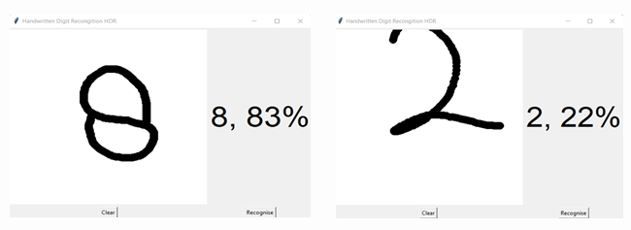
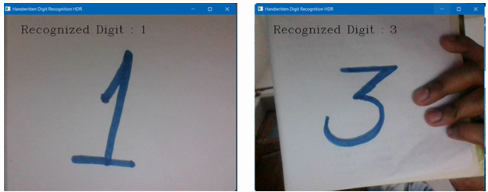
Proposed Design And Implementation continued...
USER INTERFACE:
GUI Sketchpad
Web Camera

Slide 10


Result And Analysis
01
60000 Training Samples
10000 Testing Samples
Grey-scale of 28x28 pixels
02
Batch Size = 128
Epochs = 10
Adam Optimizer
model.fit() train the model
03
Evaluating on test data
Score[0] -> Test Loss = 0.0476923
Score[1] -> Test Accuracy = 0.991400

Slide 11
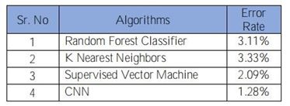
Result And Analysis continued...
We discovered that CNN provided the best accurate results. As a result, we may infer that CNN is the best choice for any form of prediction task involving picture data.
Following the model's construction, we compiled it using the Adam optimizer and a specific cross-entropy loss function, both of which are customary in the creation of a convolution neural network.
Training set size affects the accuracy and accuracy increases as the number of data increases. The more data in the training set, the smaller the impact of training error and test error, and ultimately the accuracy can be improved.

Slide 12
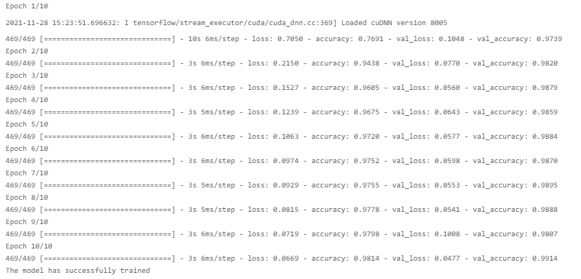
Result And Analysis continued...
Output while building the CNN model:

Slide 13
Various Algorithms
Result And Analysis continued...
We Analysed that Adam optimizer gives more Accuracy than other existing Optimizers such as Adadelta etc.
We also noticed that Epochs Cycle Variation also affects the Accuracy of our Model.
After Successfully running our Project we have attained the Accuracy which is close to 99.14 % with a very low loss percentage.

Slide 14
Conclusion
A great level of accuracy can be achieved with these deep learning approaches. In comparison to other research approaches.
CNN model with Keras as the backend and Tensorflow as the software can achieve upto 99.14 percent accuracy.
The only challenging part is the noise present in the real-world image, which needs to be looked after.

Slide 15
Future Scope
These algorithms can be used in hospitals for detailed medical diagnosis, treatment, and monitoring of patients.
In large scale it can be used to verify handwritten symbols or signature from the available server in future application.
It can be used as a tool in various applications such as Handwritten Calculator , Recognition and Retrieval of Complex Documents.
. By employing these algorithms in day-to-day applications, we can contribute to creating an environment of safety, awareness, and comfort.

